Slide 1
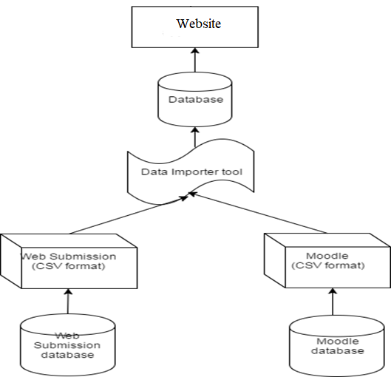
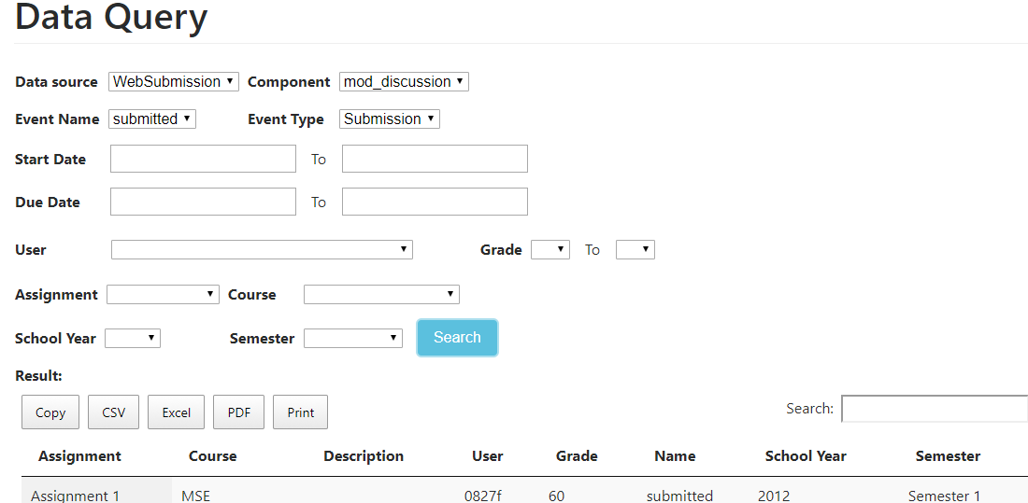
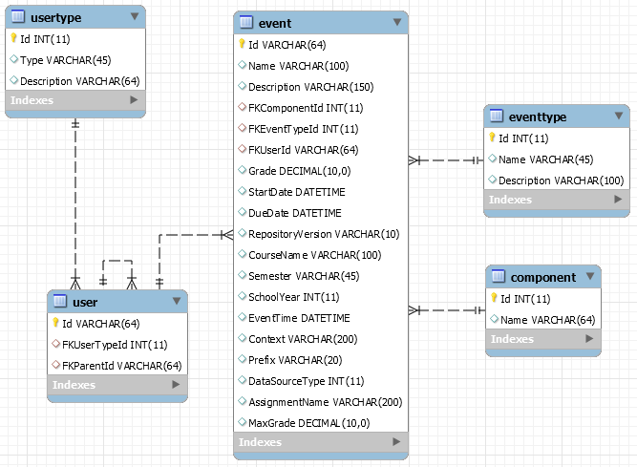
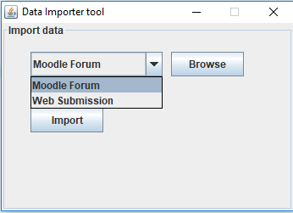
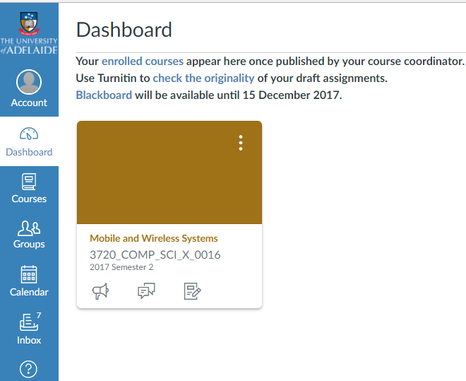
Organised Access to Historical Student Data
Zeqi Fu, Zeyu Lin, Minh Tam Phan @student.adelaide.edu.au
Supervised by Nickolas Falkner, Christoph Treude, Claudia Szabo, Marian Mihailescu
School of Computer Science
Project Introduction
System Architecture
Data query module, importer, database.
The database schema is built based on two Moodle Forum and WebSubmission data sources.
Data Importer tool extracts data from data sources to database.
The website displays and analyzes data by charts and tables.
Data Query module can support staff to query and extract data.
A combined database of Moodle Forum and WebSubmission data sources.
Can be flexibly applied for newly added data sources such as Canvas.
Data importing tool can assist to import data from data sources into database.
Charts and analysis module
Advantages
The database is flexible and can be applied for multiple data sources.
Having tools to import data from external files.
The website can be used to query, analyze and extract data with the support of charts and tables.
Project Objective
Future Work
Modify the schema to work with new Canvas data source.
Acknowledgement
This project was supported by the School of Computer Science. We gratefully acknowledge the feedback and contribution of Nickolas Falkner, Claudio Szabo, Christoph Treude and Marian Mihailescu.

